Slide 1


Melt, Crevassing, and Buttressing: A Framework for Assessing the Cook Ice Shelf’s Vulnerability
Prepared by Jeremy Shum, 07.10.25
Supervised by Felicity McCormack
arcsaef.com jshu0010@student.monash.edu Felicity.McCormack@monash.edu
SAEF, Monash University, Melbourne Victoria Australia

Slide 2
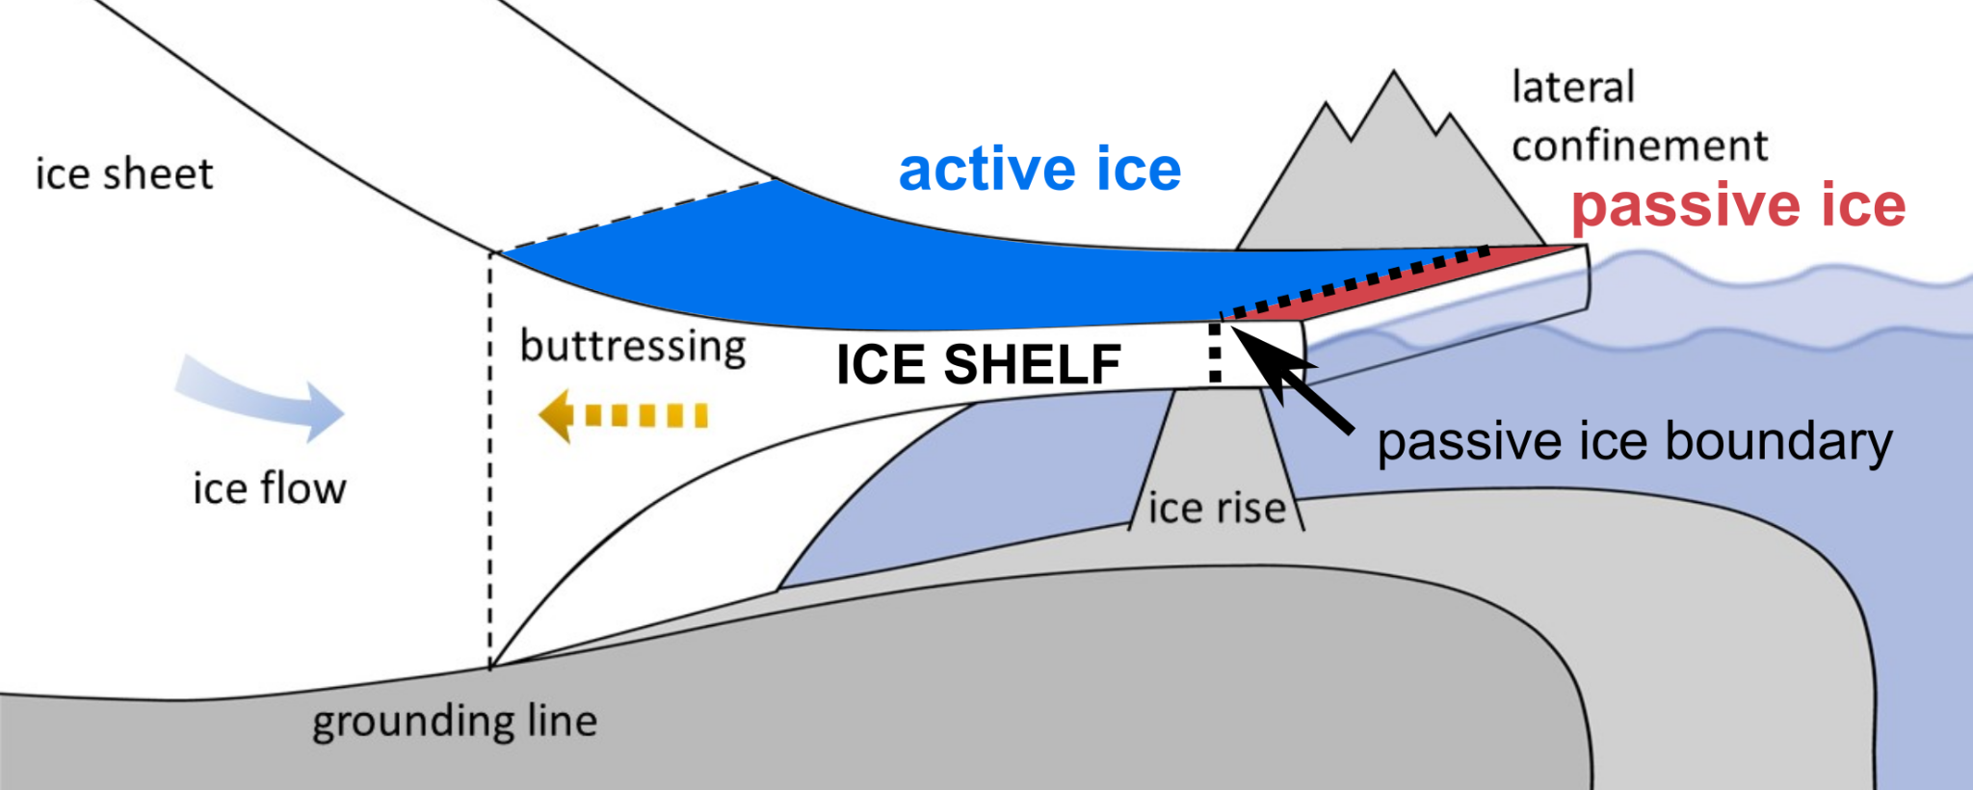
Ice Shelves Critical for Ice Sheet Stability
Understanding vulnerability of ice shelves is key to predicting Antarctica’s response to climate change, including the timing of rapid retreat
Figure 1: Characteristics of an ice shelf (Reese 2019)

Slide 3
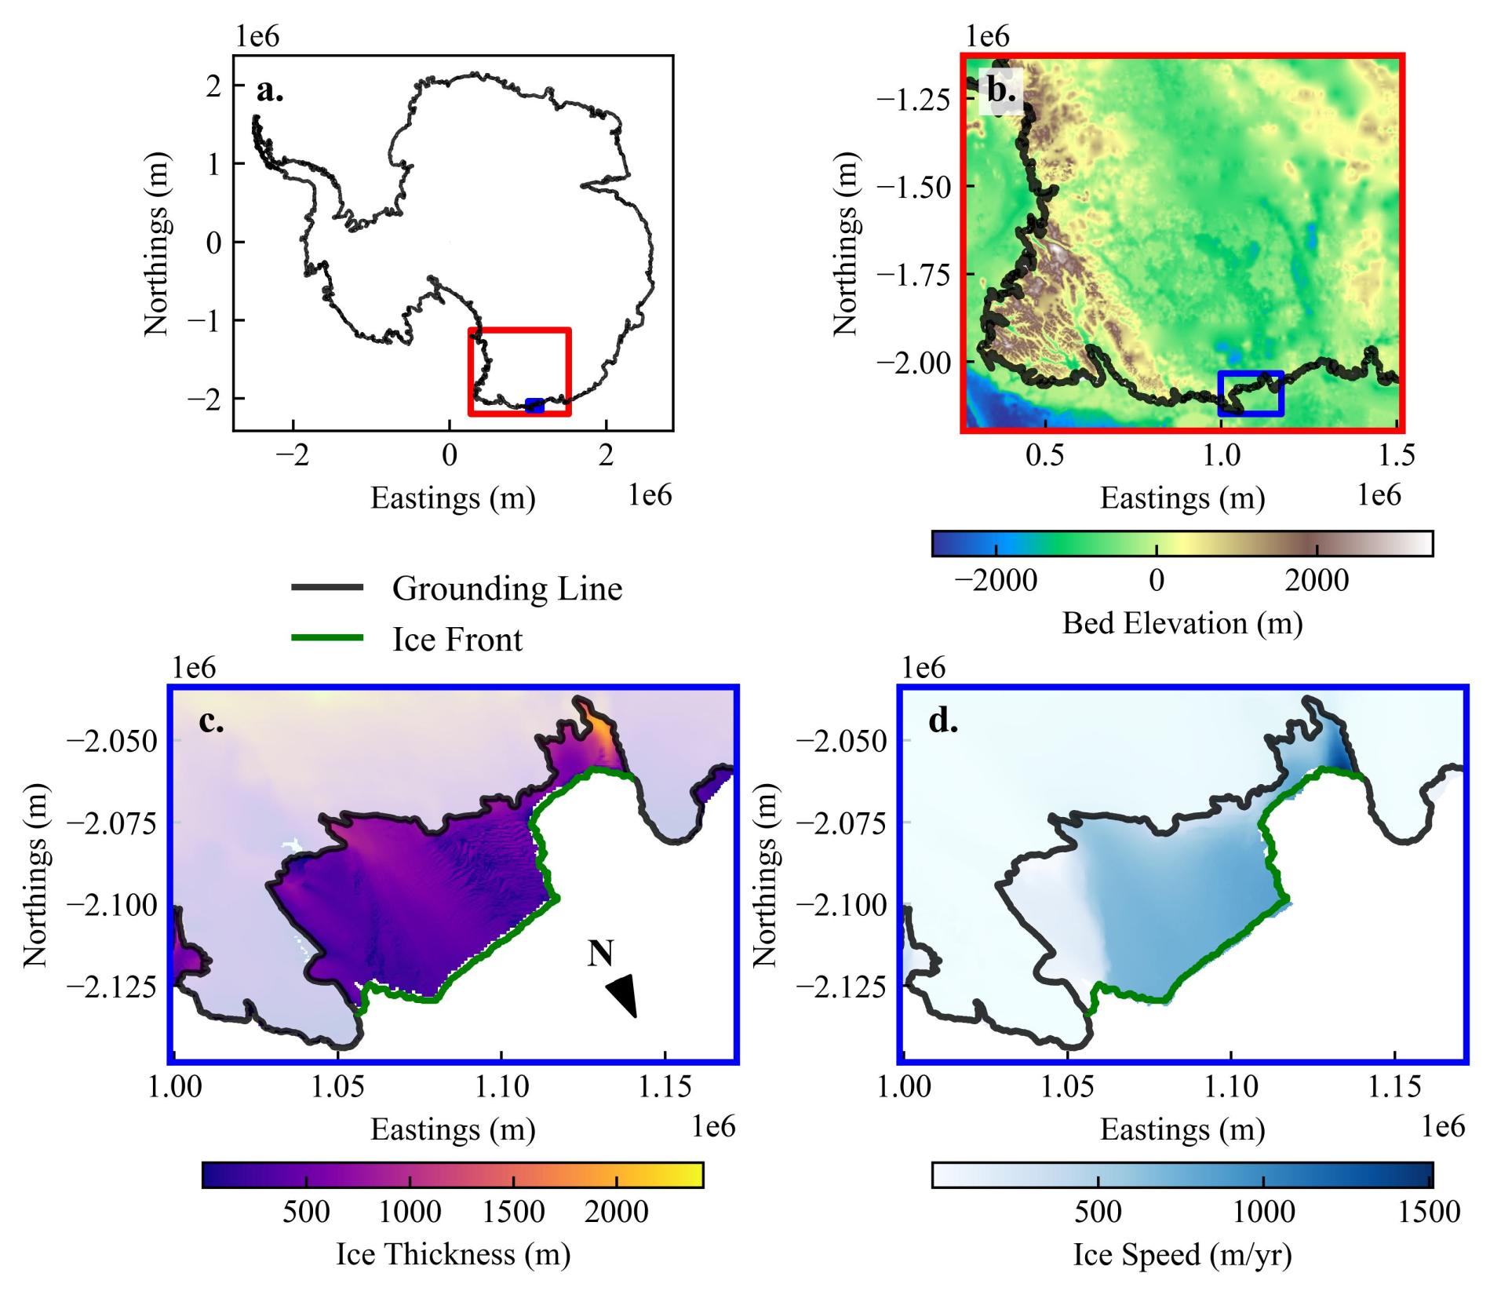
Research Aims
ss
What is the vulnerability of the Cook Ice Shelf (CIS) to climate change?
How is the ocean melting the ice shelf?
Which regions are vulnerable to crevassing?
What is the buttressing capacity of the CIS?
→ Develop decision-making framework for monitoring (e.g. ApRES for ocean-driven melt)
WEST
CIS
EAST
WSB
Figure 2: Antarctica Map and location of the Cook Ice Shelf

Slide 4
Methods
AIM: Vulnerability to Ocean-Driven Melt
WAOM:
BMR
Temperature
Salinity
(Richter et al., 2022)
Satellite Imagery
(Bindschadler et al., 2008)
Annual Velocity
(Mouginot et al., 2017)
Ice
Thickness
(Paolo et al., 2024)
Ice
Extent
(Greene et al., 2024)
Surface
Elevation
(Morlighem et al., 2020)
Melt:
Water Parcel Classification
Crevassing:
Probability / Vulnerability to Formation
Buttressing:
Max. Buttressing Number → Passive Ice Boundaries
Surface Mass Balance
Decision-making
Framework

Slide 5
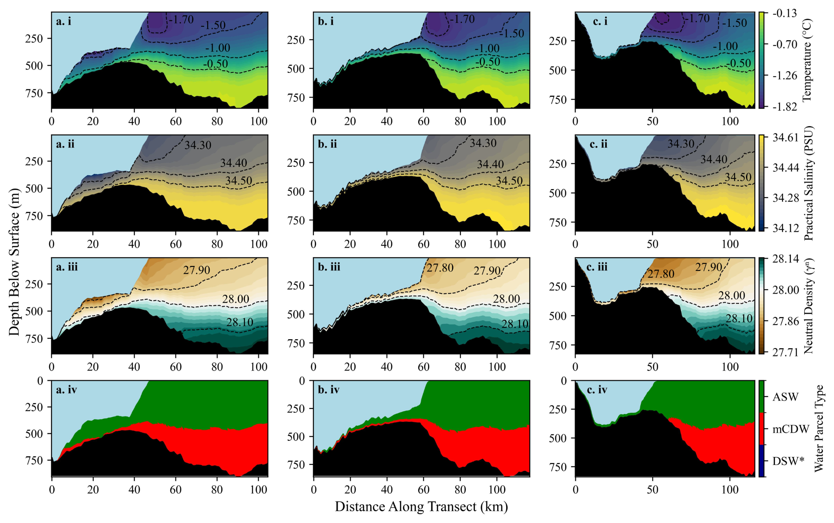
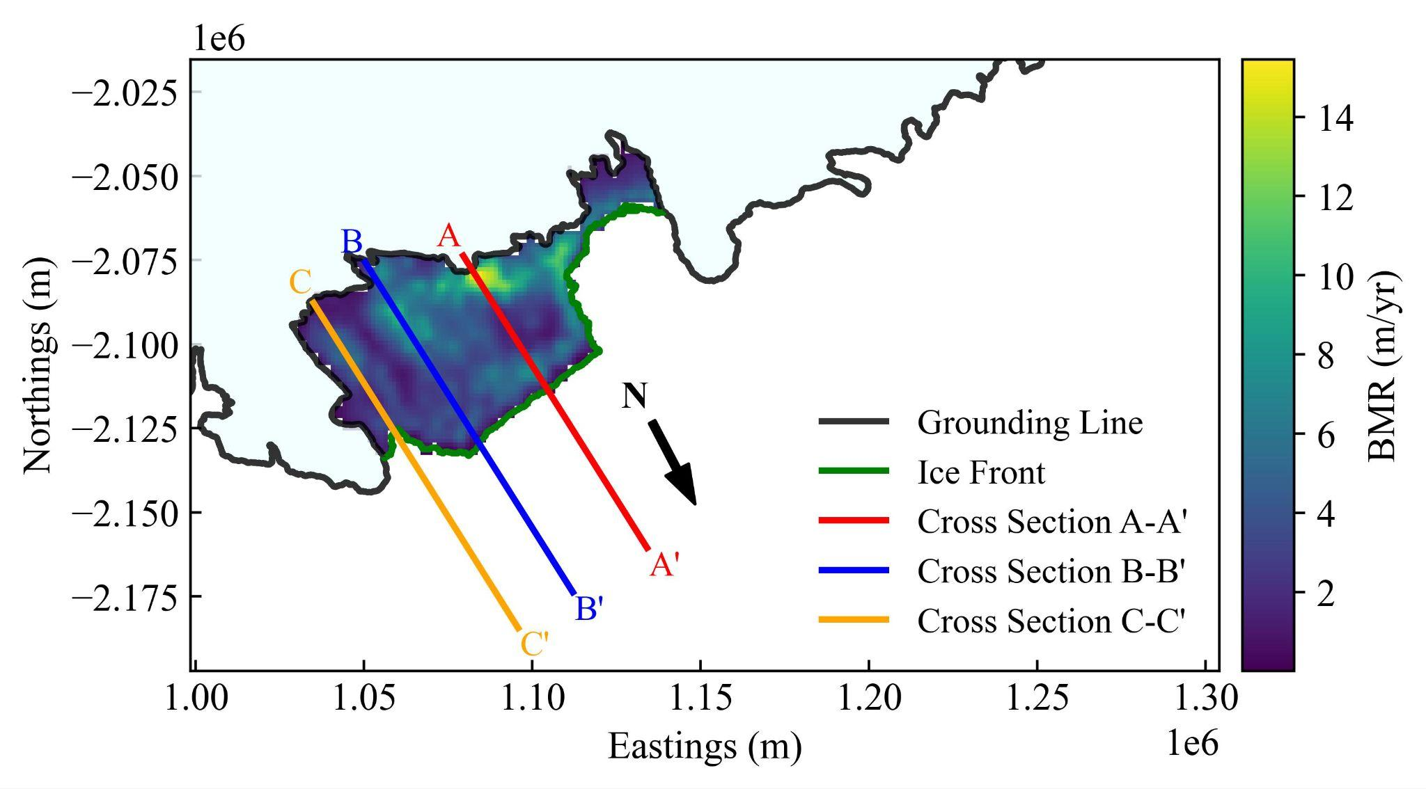
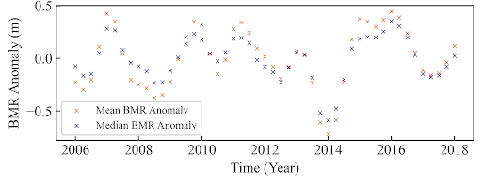
Key Result 1: mCDW is the Dominant Mode of Melt
Melt magnitude currently low, with little evidence of increased thinning
Cross Section A
Cross Section B
Cross Section C
WW
WW
Melt usually amplified by basal cavity access, but at CIS bathymetry restricts mCDW supply to grounding line. However, bathymetry poorly constrained and sparse ocean observations increase uncertainties
Figure 4: Cross section segments
Figure 3: Basal melt rate of the Cook Ice Shelf, and as a timeseries

Slide 6
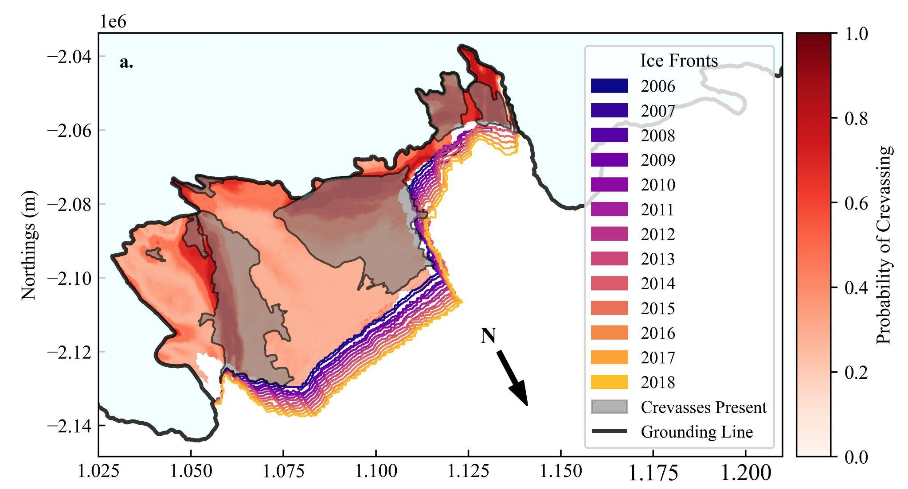
Key Result 2: Extensive Crevasses, but No Evidence of Impact on Calving
Crevasses most likely to form in the:
far west
eastern shear margin
within 5 - 10 km of the grounding line
Consistent increase in ice extent area suggests:
absence of major calving events between 2006 and 2018
crevassing not currently driving calving
WW
WW
Figure 5: Conditional probability of crevasses occurring, given the strain rate for that region. Calving front evolution over time shown in coloured lines

Slide 7
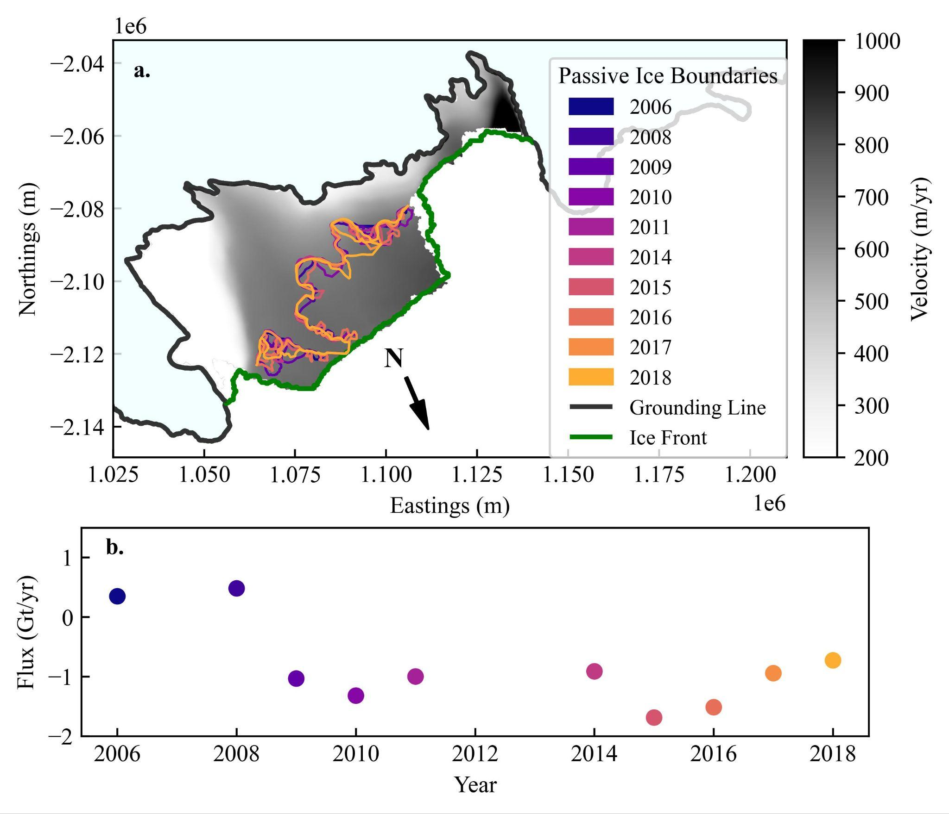
Key Result 3: No Significant Change in Buttressing
“Upper Half” = Active Buttressing Ice:
Slowing flow and thinning
“Lower Half” = Passive Ice (no buttressing):
Allows for faster flow and thinning
No substantial calving within the active zone
Decreasing Outflux (Negative):
Net Ice Gain (Thickening)
Active
Passive
WW
WW
Figure 6: (a) Passive ice boundaries. (b) The Cook Ice Shelf flux timeseries. Note that the years 2007, 2012 and 2013 are excluded due to insufficient data.

Slide 8
Overall Findings
Cook Ice Shelf is not currently thinning, with an increase in ice shelf area and no substantive change in buttressing
There is little evidence of a current response to climate change
The largest source of uncertainty is the supply of warm water into the ice shelf cavity → need for improved constraints on processes driving melt

Slide 9
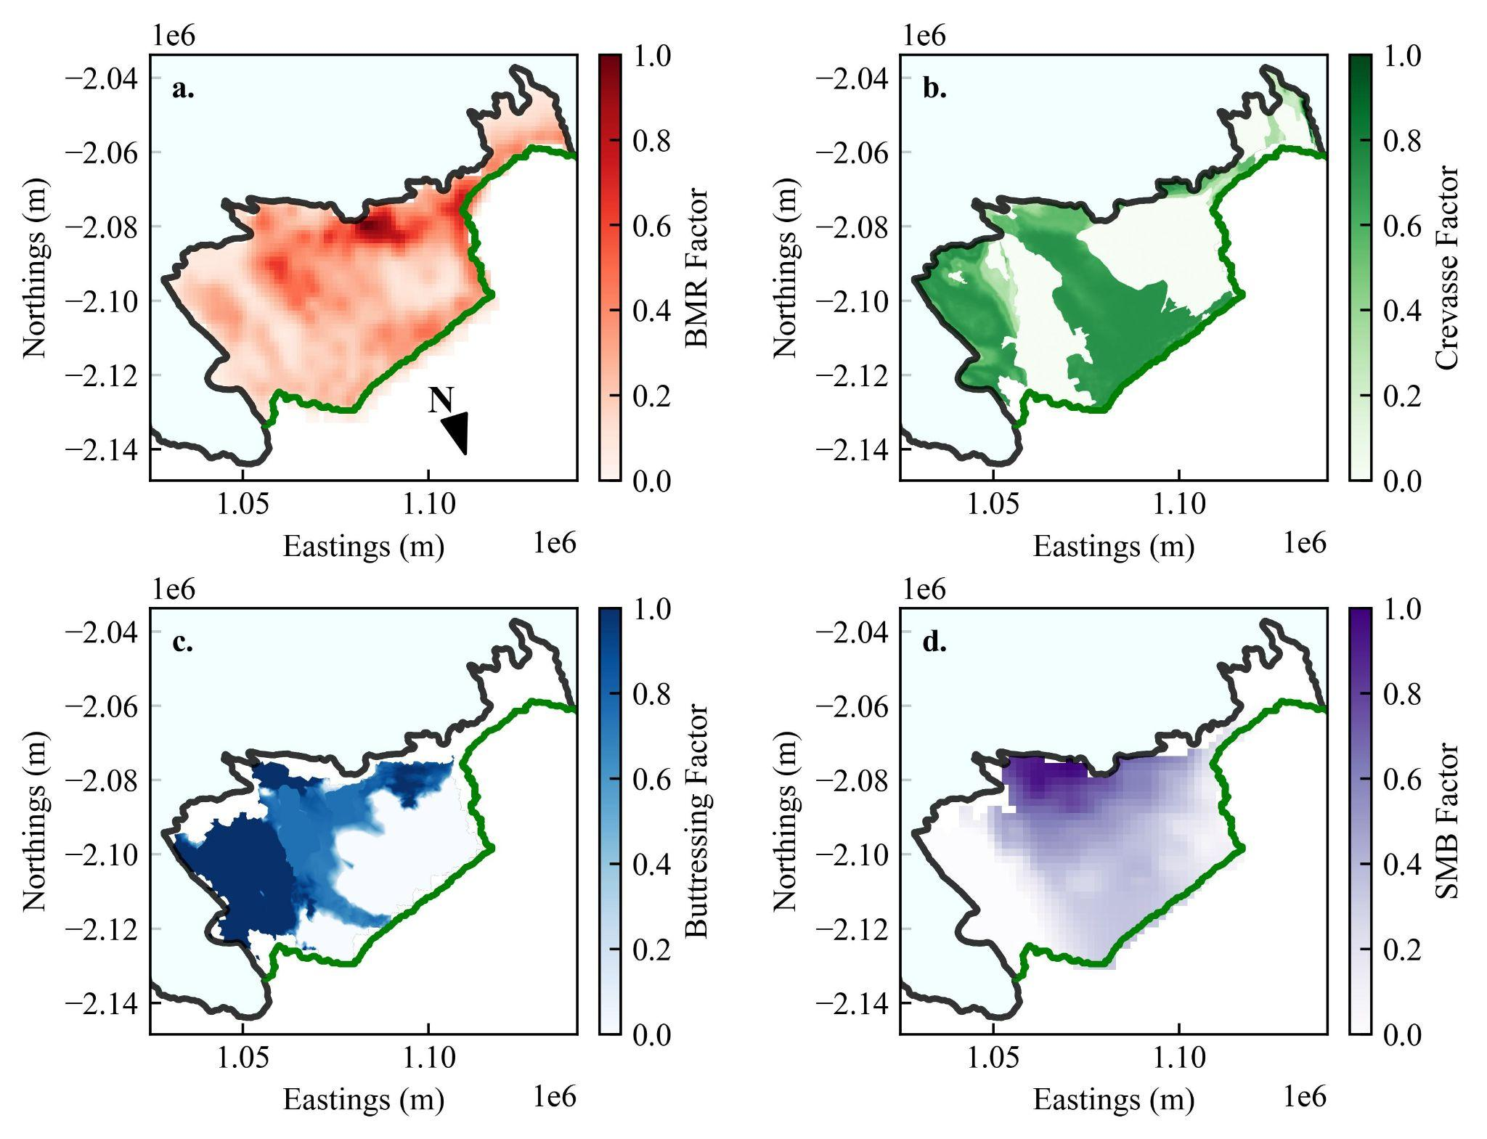
Decision-making Framework for ApRES Deployment
Framework
Fields Scaled from 0 to 1:
0 = Low Risk to Ice Shelf Vulnerability of Climate Change
1 = High Risk of Ice Shelf Vulnerability to Climate Change (target)
WW
Figure 7: Normalised factor influence attributed to (a) basal melt rates (b) crevasses (c) buttressing, and (d) surface mass balance.

Slide 10
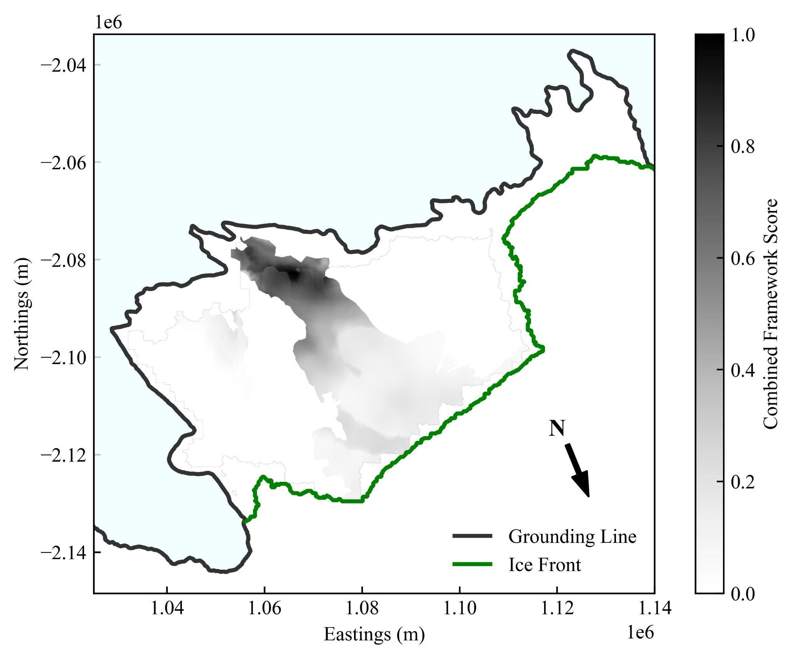
Decision-making Framework for ApRES Deployment
Framework (Cont.)
S_{Weighted} = (0.7S_{M} + 0.3S_{B}) x (1.0S_{C} x 0.8S_{S})
S_{M} = BMR score, S_{B} = Buttressing score, S_{C} = Crevassing Score, S_{S} = SMB score
Ideal Regions for ApRES Deployment:
Southern-Central Region (score >= 0.5)
Unsuitable regions:
West due to Crevasses
North due to Passive Ice
East due to High SMB
WW
WW
Figure 8: The combined ApRES deployment framework addressed for investigating experiencing intense ocean-driven melt.

Slide 11
Conclusion and Implications
Low basal melt rates suggest current low vulnerability of the CIS to climate change
Crevasses are widely present, yet no calving events suggest that the vulnerability state of the ice shelf to climate change is sufficiently stable
Consistent buttressing state indicates that the vulnerability of the CIS to climate change is yet to escalate
Uncertainties in ocean and bathymetry data call the need for a melt-based decision-making framework for ApRES deployment
→ harnessing real-life opportunities provided by Antarctic InSync projects

Slide 12
Acknowledgements and References
Supervisor: Dr. Felicity McCormack (Monash University), MISI and SAEF
BINDSCHADLER, R., VORNBERGER, P., FLEMING, A., FOX, A., MULLINS, J., BINNIE, D., PAULSEN, S. J., GRANNEMAN, B. & GORODETZKY, D. 2008. The Landsat image mosaic of Antarctica. Remote Sensing of Environment, 112, 4214-4226.
BINDSCHADLER, R. & CHOI, H. 2011. High-resolution Image-derived Grounding and Hydrostatic Lines for the Antarctic Ice Sheet [Online]. U.S. Antarctic Program (USAP) Data Center. Available: https://www.usap-dc.org/view/dataset/609489 [Accessed 3/5 2025].
FRETWELL, P., PRITCHARD, H. D., VAUGHAN, D. G., BAMBER, J. L., BARRAND, N. E., BELL, R., BIANCHI, C., BINGHAM, R., BLANKENSHIP, D. D. & CASASSA, G. 2013. Bedmap2: improved ice bed, surface and thickness datasets for Antarctica. The cryosphere, 7, 375-393.
GREENE, C., GARDNER, A., SCHLEGEL, N. & FRASER, A. 2024. MEaSUREs ITS_LIVE Antarctic Annual 240 m Ice Sheet Extent Masks, 1997-2021, Version 1. NASA National Snow and Ice Data Center Distributed Active Archive Center (DAAC) data set, 9ZFX84T5GI6D.
JACKETT, D. & MCDOUGALL, T. 1997. A Neutral Density Variable for the World's Oceans. Journal of Physical Oceanography, 27, 237-263.
LAROUR, E., SEROUSSI, H., MORLIGHEM, M. & RIGNOT, E. 2012. Continental scale, high order, high spatial resolution, ice sheet modeling using the Ice Sheet System Model (ISSM). Journal of Geophysical Research: Earth Surface, 117.
MCDOUGALL, T. J. & BARKER, P. M. 2011. Getting started with TEOS-10 and the Gibbs Seawater (GSW) oceanographic toolbox. Scor/iapso WG, 127, 1-28.
MORLIGHEM, M., RIGNOT, E., BINDER, T., BLANKENSHIP, D., DREWS, R., EAGLES, G., EISEN, O., FERRACCIOLI, F., FORSBERG, R. & FRETWELL, P. 2020. Deep glacial troughs and stabilizing ridges unveiled beneath the margins of the Antarctic ice sheet. Nature geoscience, 13, 132-137.
MOUGINOT, J., B, S. & E, R. 2017. MEaSUREs Annual Antarctic Ice Velocity Maps, Version 1 [Online]. NASA National Snow and Ice Data Center Distributed Active Archive Center. [Accessed 8/5 2025].
PAOLO, F., GARDNER, A., GREEN, C. & SCHLEGEL, N. 2024. MEaSUREs ITS_LIVE Antarctic Quarterly 1920 m Ice Shelf Height Change and Basal Melt Rates, 1992-2017, Version 1.
RICHTER, O., GWYTHER, D. E., GALTON-FENZI, B. K. & NAUGHTEN, K. A. 2022. The whole antarctic ocean model (waom v1. 0): Development and evaluation. Geoscientific Model Development, 15, 617-647.

Slide 13
Thank you, any questions?
arcsaef.com jshu0010@student.monash.edu Felicity.McCormack@monash.edu
SAEF, Monash University, Melbourne Victoria Australia

